Slide 1

Johnson & Johnson (Group 8)
Simranjeet Kaur (0792193)
Mohammad Mazhar Noor (0788801)
Anand Prakashbhai Shroff (0775235)
Emmanuel Tadese (0785252)
Sougata Dey(0802627)

Slide 2

Content
About The Company
Macro –Economic Environment
Ratios and CAPM
Monte Carlo Simulation (MCS)
Time Series Analysis
Forecasting

Slide 3

About the company
Johnson & Johnson is a multinational corporation that was founded in 1886 in New Brunswick, New Jersey.
The company specializes in the development of medical devices, pharmaceuticals, and consumer packaged goods. It is one of the world's most valuable companies, with operations in 60 countries and products sold in over 175 countries.
Johnson & Johnson (J&J) was engaged in several different initiatives across its various business segments. Here are a few examples:
COVID-19 vaccine: J&J was one of several companies that developed a COVID-19 vaccine.
Medical devices: J&J's medical device business continued to develop and market a wide range of products, including surgical instruments and cardiovascular devices.

Slide 4

Macro-economic environment
Johnson & Johnson (J&J) operated in a macroeconomic environment that was characterized by a mix of opportunities and challenges.
Here are a few key factors that may have impacted J&J's business cycle and industry environment:
Economic trends: J&J operated in a global economy that was recovering from the impacts of the COVID-19 pandemic. Economic trends such as interest rates, inflation, and consumer spending could have an impact on demand for healthcare products and services.
Regulatory environment: J&J operated in a highly regulated industry, with various government agencies overseeing the safety and efficacy of its products.
Innovation and competition: J&J faced competition from other major pharmaceutical and medical device companies, as well as from smaller startups and innovators. The company's ability to develop new products and technologies, and to bring them to market quickly and efficiently, would be key to maintaining its competitive edge.

Slide 5
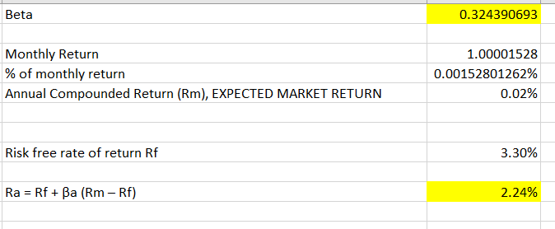
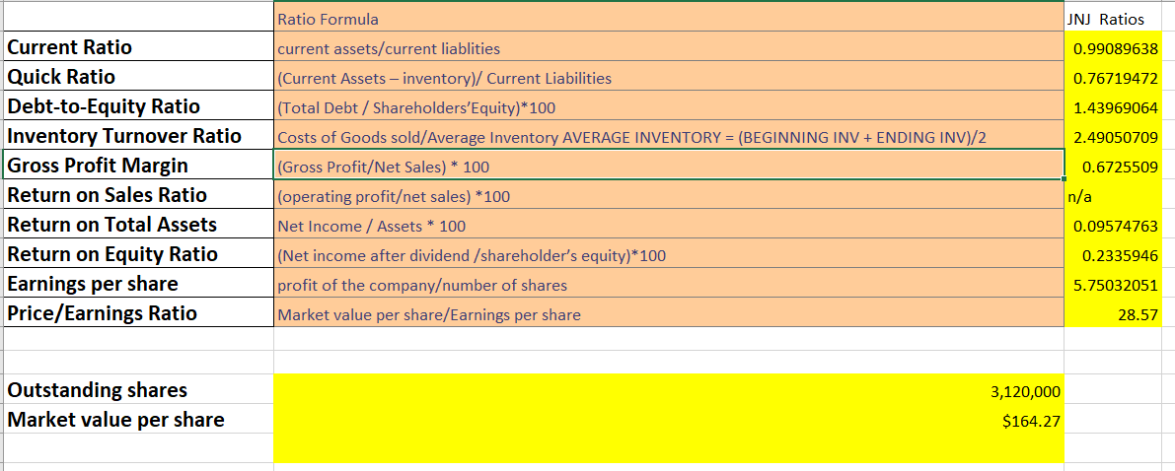
Ratio & CAPM
A beta value of 0.324390692585024 suggests that the company's stock is less volatile than the broader market. This means that the stock is expected to experience smaller fluctuations in price compared to the overall market. Investors who are risk-averse may prefer to invest in stocks with lower beta values since they are considered to be less risky. while the low beta value suggests that the stock may be less risky than the overall market, a comprehensive analysis of the company's overall performance and future growth prospects should be conducted before making an investment decision.
A beta value of 0.53 suggests that J&J's stock is moderately correlated with the broader market and may experience larger fluctuations in price compared to the overall market. In contrast, the company in the has a beta value of 0.324390692585024, indicating that its stock is less volatile than the market.

Slide 6
Monte Carlo Simulation
Monte Carlo simulation of a particular stock predicts a range of potential returns between 152 and 163, this means that based on the input parameters, the expected return falls within this range with a certain level of confidence.
The results of Monte Carlo simulation can provide valuable insights to investors and traders, helping them to make more informed decisions and manage risk more effectively. By providing a range of potential outcomes, Monte Carlo simulations can also help investors to identify the likelihood of extreme events or tail risks, which may not be captured by traditional risk management methods.

Slide 7

Time Series Analysis
When the short-term moving average crosses above the long-term moving average, this indicates a buy signal. Contrary, when the short-term moving average crosses below the long-term moving average, it may be a good moment to sell.
Comparison With actual Yahoo data
After comparing the Buy/Sell signals for the SMA 50 and SMA 100 of Johnson and Johnson Platforms with the data on Yahoo Finance, it was discovered that there were discrepancies. Specifically, these discrepancies occurred on four different dates, namely 2021-06-11, 2021-10-22, 2022-07-25, and 2023-02-23.

Slide 8

Forecasting Based on the analysis provided, it seems that the Monte Carlo simulation gives a more accurate measure of the stock price range compared to the EMA forecasting. This may be because the Monte Carlo simulation takes into account a wider range of possible outcomes and can generate a more realistic range of prices. Upon comparing the prices between Monti-Carlo Simulation and EMA the results were fairly similar the estimated prices range between 155 to 180.
Regarding the error distribution, the fact that the majority of the errors are positive and that the EMA is overestimating the price of shares suggests that the EMA may not be the most suitable forecasting technique for this particular stock. It may be worth exploring other forecasting techniques, such as the Simple Moving Average or the Weighted Moving Average, to see if they produce more accurate results.
Additionally, it is important to note that stock price forecasting is a complex and challenging task, and no single technique can guarantee accurate results. It is important to regularly review and adjust the forecasting techniques based on the changing market conditions and other factors that may impact the stock price.

Slide 9

Thank You

